Slide 1
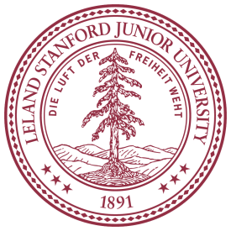
Optimizing Timing of Transplant in Hodgkin Lymphoma
Ginna G. Laport, MD
Associate Professor of Medicine
Division of Blood & Marrow Transplantation
Stanford University Medical Center
Notes:
The last decade has seen remarkable improvement in response rates and survival in patients with DLCL mainly due to the addition of RTX to standard first line chemo-immunotherapy, mainly the combination of CHOP and R.
But despite the dramatic improvement in outcomes, relapse is still the main cause of death in this patient population.
This had led investigators to explore if high dose chemo with autosct after conventional induction chemoimunotherapy can improve outcomes of pts who we think are destined to relapse

Slide 2
Hematopoietic Cell Transplantation in Hodgkin Lymphoma
Prognostic Factors
Salvage Regimens
Conditioning Regimens
Novel Agents
Allogeneic HCT

Slide 3
Transplant Activity Worldwide
1968-2012
Transplants
Notes:
Slide 14: One-year survival rates after transplantation have generally improved in the last two decades. Outcomes of unrelated donor transplants are approaching those observed with related donors. Improvements in HLA-matching techniques, with consequently better donor selection, better overall patient selection for transplantation, and improvements in supportive care are the likely explanation for this trend.

Slide 4
Indications for Hematopoietic Stem
Cell Transplants in the U.S.
Number of Transplants
Notes:
Slide 8: The most common indications for HCT in the United States in 2009 were multiple myeloma and lymphoma, accounting for 60% of all HCTs. Multiple myeloma continue to be the most common indication for autotransplantation and acute myeloid leukemia for allogeneic transplantation.

Slide 5
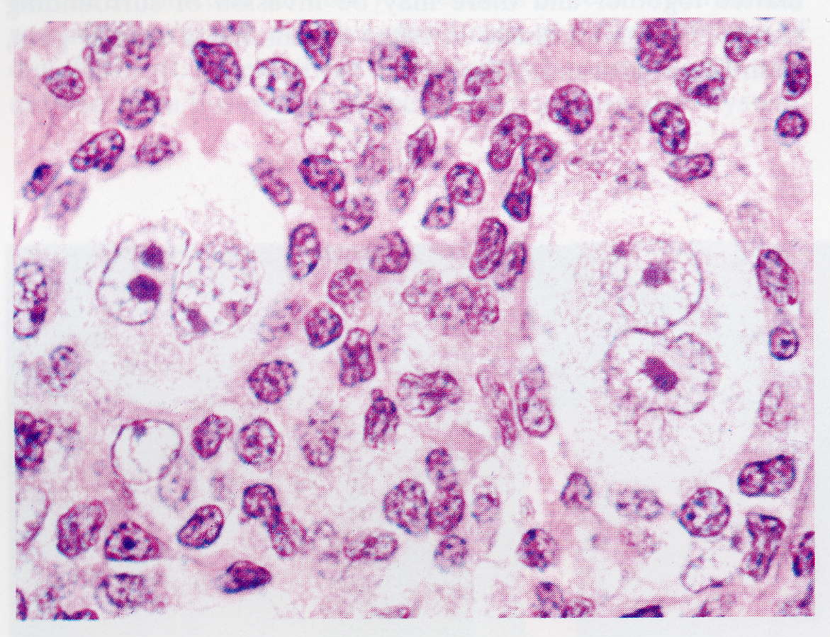
Hodgkin’s disease
7,600 new cases/year in USA
20,000 new cases annually in N. America and Europe
Bimodal peak age of incidence
    15-40 yo
    60-70 yo
5 subtypes
    Nodular sclerosing (75%)
    Lymphocyte rich (15%)
    Lymphocyte deplete
    Mixed cellularity
    Nodular Lymphocyte predominant
Classical
Reed-Sternberg cells
Notes:
Most common malignancy in young adults
Named after Thomas Hodgkin, an English physician. Occurs in early adulthood and late adulthood
Under the WHO/REAL classification, there are 5 subtypes divided into 2 main categories, classical HD which accounts for 95% and nod LP which accts for 5%.
1)NS comprises close to 70% and bx shows scar tissue(sclerosis) and numerous RS cells
2)Mostly reactive lymphocytes and “popcorn” appearance cells; very few RS cells ; 5%
3) 5%
4) RS cells and inflammatory cells; 30% of HD
5)Nod LP – This one is in a category of its own. Typical RS cells are rare to nonexistent and instead has variants called popcorn cells; indolent though relapsing course with excellent prognosis; tends to be restricted to cerv LN as opposed to mediastinum; not bimodal, peak in 30s and 40s; can relapse as hi grade B cell NHL
HD is the less common form of lymphoma. What differentiates HD is the presence of the RS cell in the LN or bone marrow and it is known that the cancerous cells arise from B cells. The EBV also appears to be a factor in about 40-50% of cases.
Physicians distinguish Hodgkin's disease from other types of lymphoma, in part, by examining tissue samples under a microscope; biopsied tissue from patients with Hodgkin's disease includes a certain number of cells called Reed-Sternberg cells (named after the two physicians who first described them). These distinctive cells are bigger than normal cells and have large, pale nuclei (the site in each cell where chromosomes -- genetic material -- are located). Researchers have recently discovered that Reed-Sternberg cells almost always originate from B cells. In about half of patients with Hodgkin's disease the tumors can be shown to express proteins associated with the Epstein-Barr virus.
In Hodgkin's disease, the tumors spread from lymph node group to lymph node group via the lymphatic vessels. The most common site of involvement is the lymph nodes in the chest; this region is called the mediastinum.
With advances in dx and tx, approx 80% are cured
Survival by Stage
1 = 90-95%
2 = 90-95%
3 = 85-90%
4 = ~ 80%

Slide 6
Hodgkin Lymphoma
Therapy
  ABVD
  MOPP
  MOPP/ABVD
  Stanford V-VI
Survival by Stage
  Stage 1 = 90-95%
  Stage 2 = 90-95%
  Stage 3 = 85-90%
  Stage 4 = ~ 80%
For relapsed or refractory Hodgkin lymphoma →
standard of care is autologous HSCT

Slide 7
Autologous HSCT for Hodgkin Lymphoma
100
100
80
BEAM (n=20)
80
BEAM (n=20)
60
60
40
Mini-BEAM (n=20)
40
20
20
p=0.318
p=0.025
Mini-BEAM (n=20)
0
0
0
1
2
3
4
5
0
1
2
3
4
5
Years
Years
Linch et al; Lancet 1993;341:1051

Slide 8
Survival after Autologous Transplant for Hodgkin Disease, 2000-2009
- By Disease Status -
100
100
90
90
CR (N=2,419)
80
80
70
70
60
60
Probability of Survival, %
Not in CR, sensitive (N=2,826)
50
50
40
40
Not in CR, resistant (N=642)
30
30
20
20
10
10
P < 0.0001
0
0
0
1
2
3
4
5
6
Years
Notes:
Slide 33: Transplantation for Hodgkin Disease (HD) is indicated in patients who have failed initial chemotherapy or radiation therapy. Survival after HCT for HD depends on disease response to previous salvage therapy. Among the 5,887 patients receiving autotransplants for HD between 2000 and 2009, the 3-year probabilities of survival were 84% ± 1%, 71% ± 1%, and 50% ± 2% for patients in complete remission, in partial remission, and with chemoresistant disease, respectively.

Slide 9
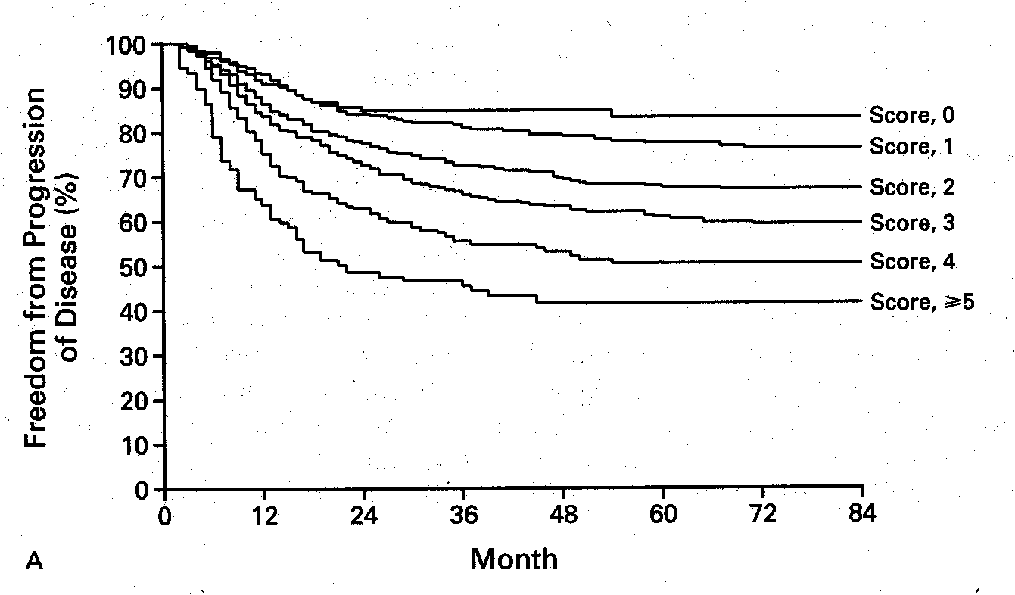
International Prognostic Factors Project: Advanced Stage Classical Hodgkin’s Disease
Factor Criteria
Age > 45
Gender male
Stage IV
Albumin < 4.0 g/L
WBC > 15 x 10⁹/L
Hemoglobin < 10.5 g/L
Lymphs < 600 or < 8%
FFP
0-2=74%
3-7=55%
n=5141
Hasenclever et al, NEJM 1998;339:1506
Notes:
N=5141 at 25 centers

Slide 10
Prognostic Factors for Rel/Refractory Hodgkin patients
1.0
Score 0
German Hodgkin Group
Presence of anemia
Stage 3 or 4 at relapse
Remission duration < 12 mos
0.8
Score 1
0.6
Probability
0.4
Score 2
0.2
Score 3
0
p<0.0001
0
12
24
36
48
60
72
84
96
108
Months
European BMT Registry
Stage 3 or 4 at diagnosis
Use of radiation tx
Remission duration < 12 mos
1.0
0-1 RF
0.8
0.6
OS (%)
2 RF
0.4
0.2
≥3 RF
Josting et al. J Clin Oncol 2002;20:221
0
P=0.00001
0
24
48
72
96
120
144
168
192
Sureda A et al, Ann Oncol 2005;16:625
Months
Notes:
Ghsg
Significant adverse prog factors for OS identified in MVA were

Slide 11
Role of Functional Imaging in Predicting Outcome after Autologous HSCT
- 153 patients with rel/ref Hodgkin lymphoma
- Scanning by Gallium or PET after ICE salvage but
before autologous SCT
1.0
1.0
PETnegative
0.8
Gallium negative
0.8
0.6
0.6
Cumulative EFS
Cumulative EFS
PETpositive
0.4
0.4
Gallium positive
0.2
0.2
p<0.0001
P=0.003
0
0
0
3
5
8
10
13
0
2
4
6
8
Years
Years
Moskowicz AJ, et al Blood 2010;116:4934
Notes:
In addtiion to clin factors, the expanded use of FI most commonly PET has been identified as a critical predictor of outcome.
This show an analysis of 153 pts at MSKCC who received ice salvage chemotherapy, underwent scanning and then proceeded to autoSCT

Slide 12
Optimal Salvage Regimen Prior to Autologous SCT?
 | Complete Response % | Overall Response %
ICE | 26 | 85
DHAP | 21 | 89
GDP | 17 | 69
GVD | 19 | 70
MINE | NR | 75
Bendamustine | 33 | 53

Slide 13
Conditioning Regimens with
Autologous HSCT
Institutional preference
TBI-based regimens largely abandoned
BEAM (bcnu, etoposide, ara-c, melphalan) most commonly used
CBV (cyclophosphamide, bcnu, vp16)
Novel Conditioning Regimens
  Gemcitabline/Bu/Mel
  BeEAM (bendamustine)
Notes:
There have been no prospective trials comparing cond regimens as part of ascht and the choice is usually based on institutional preference.
As with the experience of salvage therapy, there are no prospective data to suggest the superiority of one regimen over another

Slide 14
Improving Outcome after
Autologous HSCT
Long term outcomes:
  If CR > 2 years → 10 yr OS is 77%
If destined to relapse, will relapse within 1yr
  Median time to progression = 6 mos
  Median survival time from 2nd relapse = 25 mos
Relapse < 6 mos → poor prognosis

Slide 15
Improving Outcome after
Autologous HSCT
Tandem Autologous HSCT ( 2 studies)
  GELA , n= 43
    75% completion
    2 yr OS: 74% vs 40%
  City of Hope, n = 46
    83% completion
    5 yr PFS and OS = 49% and 54%,
Notes:
Early rel, induction failure

Slide 16
Improving Outcome after Autologous HSCT:
Maintenance Therapy post-HSCT
Brentuximab
  Randomized phase 3 study after autologous HSCT for high risk patients (completed)
    h/o refractory disease
    Relapse or progression within 1 yr of frontline chemo
    Extranodal disease at time of relapse
Promising agents
  everolimus
  panobinostat
  lenalidomide

Slide 17

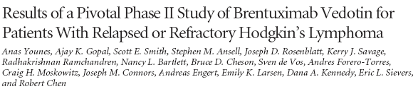
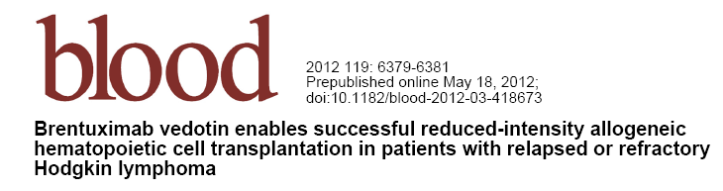
Overall RR = 75%
CR rate = 34$
J Clin Oncol 2012
Blood 2012

Slide 18
Chen et al Blood 2012;119:6379
N = 18
OS
1.0
1.0
0.8
0.8
PFS
0.6
0.6
Survival probability
Cumulative incidence
0.4
0.4
Rel/progression
0.2
0.2
NRM
0
0
0
3
6
9
12
15
18
21
24
0
3
6
9
12
15
18
21
24
Months from transplant
Months from transplant

Slide 19
Survival after Allogeneic Transplants for Hodgkin Disease, 2000-2009
- By Donor Type -
100
100
90
90
80
80
70
70
60
60
Probability of Survival, %
50
50
Sibling Donor (N=302)
40
40
30
30
20
Unrelated Donor (N=183)
20
10
10
P < 0.0001
0
0
0
1
2
3
4
5
6
Years
SUM-WW11_33.ppt
Notes:
Slide 34: Allogeneic HCT for HD is generally performed in patients who experience disease relapse after receiving multiple lines of therapy including autotransplant or who have refractory disease and an available HLA-matched donor. Among 485 patients receiving allotransplants for HD between 2000 and 2009, the 3-year probabilities of survival were 44% ± 3% and 37% ± 4% after sibling and unrelated donor transplants, respectively.

Slide 20
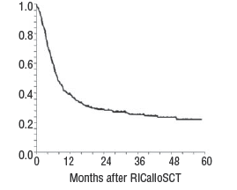
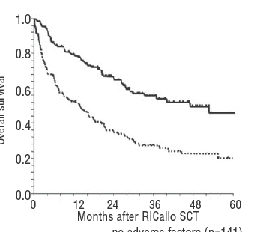
Reduced Intensity Allogeneic HCT for Hodgkin Lymphoma
European BMT Adverse Factors:
N = 285 - poor performance status
80% prior autoHSCT - age > 45 yo
25% refractory disease - refract ory disease
Overall survival
Overall survival
0 adv factors
1-2 adv factors

Slide 21
Hematopoietic SCT for
Hodgkin Lymphoma
Remission duration < 12 mos from frontline chemotherapy is strong predictor of outcome
Optimal regimen snot defined
  Salvage : ICE , GDP, GND most commonly used
  Conditioning: BEAM
Brentuximab promising for salvage, conditioning and maintenance therapy
Allogeneic HSCT can salvage about 20% of failed autoHSCT pts

Slide 22
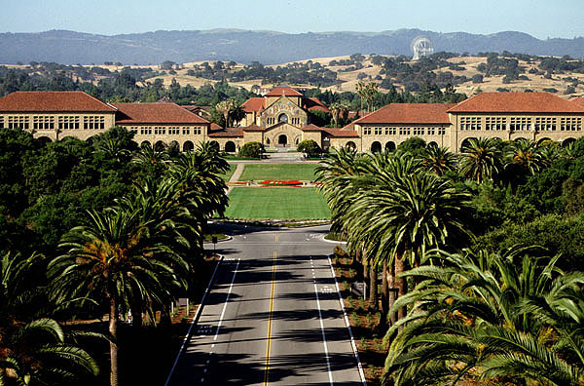
Stanford University

