Slide 1
Factor Inhibitors: Cases
Lisa N Boggio, MS, MD
Rush University Medical Center

Slide 2
Case 1
12-year-old patient with severe FVIII deficiency and inhibitor
Normally treats bleeds with rFVIIa ~100 µg/kg
Develops pain in arm

Slide 3
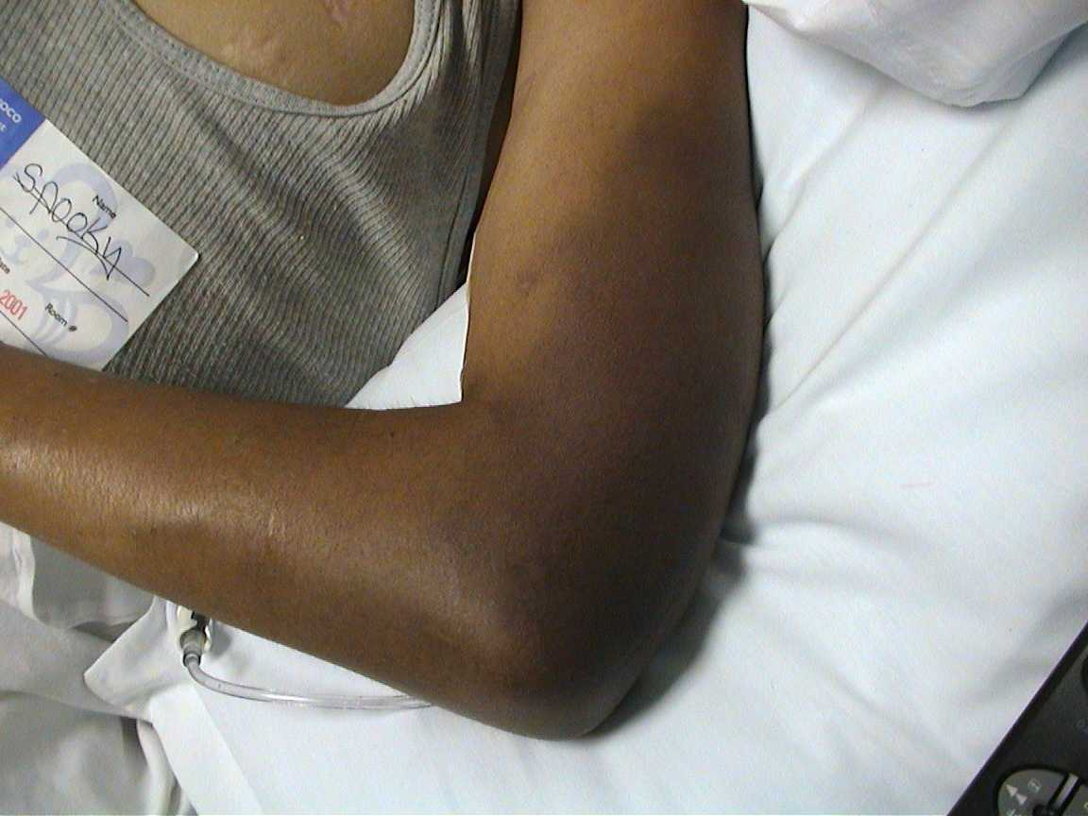
Case 1

Slide 4
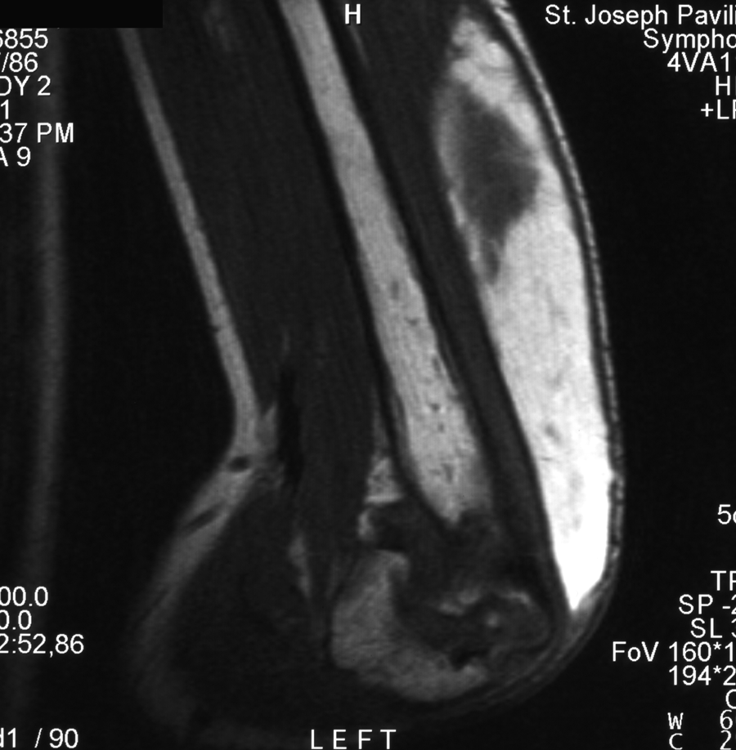
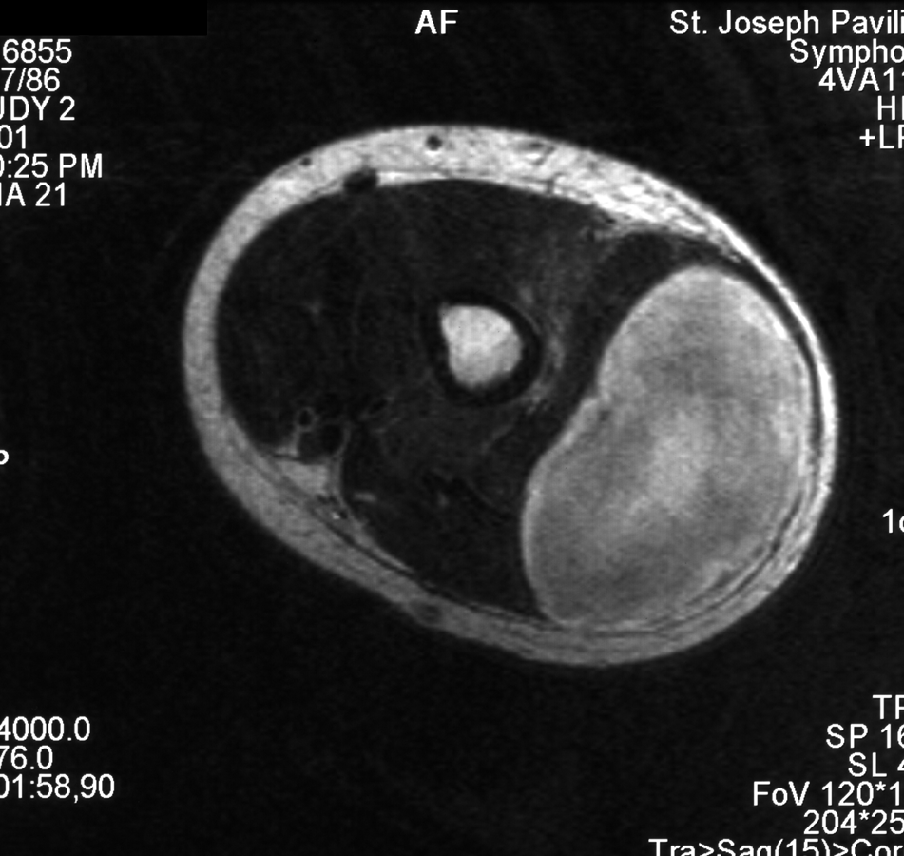
Case 1

Slide 5
Case 1: Treatment
Initiated treatment with rFVIIa 100 µg/kg q3 hours for 6 doses
Pain worsened
Examination with increased arm swelling

Slide 6
Case 1: Questions/Discussion Points
What are the treatment options at this point?
  Continue the same treatment?
  Increase rFVIIa dose?
  Switch to aPCC?

Slide 7
Follow-up retrospective study evaluated 35 admissions and 115 days of sequential therapy
Patients responded after a median of 3 days of sequential therapy after failing to respond for a median of 3 days of monotherapy
No thrombotic events, elevations in D-dimer

Slide 8
Sequential Therapy Regimens
Hour | Regimen 1 | Regimen 2 | Regimen 3
0 | aPCC | aPCC | aPCC
2
4
6 | rFVIIa | rFVIIa | rFVIIa
8 |  | rFVIIa | rFVIIa
10 |  |  | rFVIIa
12 | aPCC | aPCC | aPCC
14
16
18 | rFVIIa | rFVIIa | rFVIIa
20 |  | rFVIIa | rFVIIa
22 |  |  | rFVIIa
24 | aPCC | aPCC | aPCC
Of these, regimen 1 was used most frequently with regimens 2 and 3 reserved for the most severe bleeds
aPCC=activated prothrombin complex concentrate; rFVIIa=recombinant factor VIIa

Slide 9
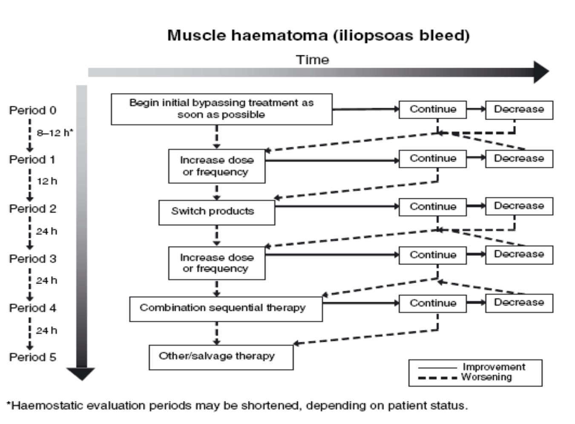

Slide 10
Case 2
15-year-old male with FVIII deficiency and inhibitors
Multiple severe bleeding episodes over the past 2 years
  Numerous joint bleeds, muscle bleeds
  2 severe retroperitoneal bleeds
Has been hospitalized for 20% of the days in the past year for bleed and pain management
Is now wheelchair bound due to arthropathy and deconditioning from immobility for much of the past year

Slide 11
Case 2: Questions/Discussion Points
Is this patient an appropriate candidate for prophylactic therapy?
If so, why?
What benefits could this patient expect if he has a good response to prophylaxis?

Slide 12
rFVIIa Prophylaxis Study:
** ***
– 27%; –50%
7
*** ***
– 45%; –59%
6
90 µg/kg
*
+35%; +22%
270 µg/kg
5
4
Mean No. of Bleeds per Month
3
2
1
0
Preprophylaxis
Period
Prophylaxis
Period
Postprophylaxis
Period
Bracketed data are the estimated changes (%) in no. of bleeds/month (defined as 28 days) for the 90 µg/kg and 270 µg/kg rFVIIa treatment groups during the prophylaxis or postprophylaxis period as compared with the preprophylaxis period, and during the prophylaxis period as compared with the postprophylaxis period. ***P≤0.001; **P≤0.01; *P≤0.05.

Slide 13
rFVIIa Prophylaxis Quality of Life
80
60
% Patients With No Problems
40
EQ-5D dimension
Anxiety
Self-care
20
Pain
Unusual activities
Mobility
0
Screening
Preprophylaxis
End of Prophylaxis
End of Postprophylaxis

Slide 14
aPCC Prophylaxis Case Series
 |  |  |  | Joint ROM |  |  | Bleeding
Author | Year | N | Unit/Wk | Better | No Δ | Worse | Reduction
Valentino | 2009 | 6 | 700 | NR | NR | NR | 100%
Leissinger | 2007 | 5 | 225 | 1 | 4 | 0 | 78%
Ohga | 2007 | 1 | 150 | NR | NR | NR | 100%
DiMichele | 2006 | 14 | 245 | 3 | 8 | 2 | 53%
Siegmund | 2005 | 1 | 210 | 1 | 0 | 0 | NR
Hilgartner | 2003 | 7 | 375 | 2 | NR | 7 | NR

Slide 15
Case 3
  53-year-old active male with FVIII deficiency and inhibitors
  Target joint (right knee), difficulty walking
  Considering elective orthopedic surgery

Slide 16
Case 3: Questions/Discussion Points
What are the options for preventing bleeding in the peri-operative period?
Prevent bleeding in this patient with rFVIIa vs aPCC?
What are the potential risks of using bypassing agents to manage this patient?

Slide 17
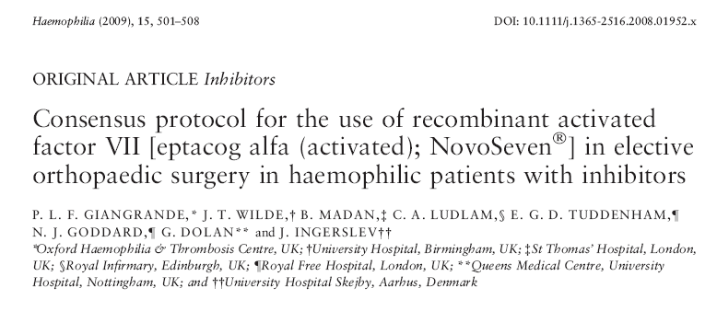
10 operations: 13 procedures in 8 patients
Preoperative bolus of rFVIIa 120-180 µg/kg
Good control of hemostasis during surgery
Final outcome rated as “excellent” or “extremely satisfactory”

Slide 18
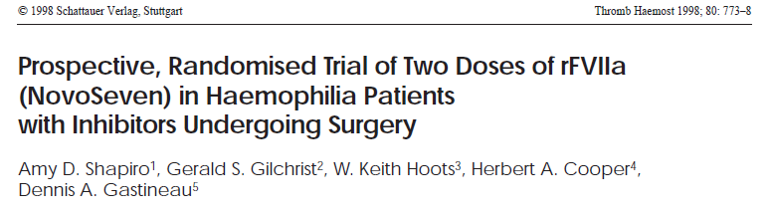
 | Minor surgery |  | Major surgery
Median (range) | 35 µg/kg (n = 10) | 90 µg/kg (n = 7)* | 35 µg/kg (n = 5) | 90 µg/kg (n = 6)
Duration of dosing (days) | 4.0 (3-6) | 6.0 (3-6) | 15.0 (2-26) | 9.5 (8-17)
Number of injections | 29.5 (24-44) | 38.0 (26-67) | 135.0 (11-186) | 81.0 (71-128)
Total dose of rFVIIa (mg) | 45.5 (14-171) | 67.0 (31-122) | 656 (31-839) | 569 (107-698)

Slide 19
rFVIIa in Patients With Hemophilia and Inhibitors Undergoing Surgery: Efficacy
 | Patients With Satisfactory Hemostasis* (%) Minor Surgery Major Surgery |  |  |  | P-Value
Time Point | 35 µg/kg (n = 10) | 90 µg/kg (n = 8) | 35 µg/kg (n = 5) | 90 µg/kg (n = 6) | 35 µg/kg vs 90 µg/kg
OR | 100 | 88 | 100 | 100 | NS
Hour 0 | 90 | 100 | 100 | 100 | NS
8 | 90 | 100 | 80 | 100 | NS
24 | 100 | 100 | 80 | 100 | NS
48 | 90 | 100 | 60 | 100 | NS
Day 3 | 80 | 100 | 40 | 100 | 0.014
4 | 70 | 100 | 40 | 100 | 0.008
5 | 70 | 100 | 40 | 83 | 0.030

Slide 20
Procedure | No. of Procedures | Hematological Treatment | Result | Complications
Radiosynoviorthesis | 20 | All with aPCC | 19 good, 1 fair | 1 postinjection bleeding
Total knee arthroplasty | 3 | 2 with aPCC, 1 with rFVIIa | 2 good, 1 fair | 1 postoperative bleeding
Fixation of femoral neck fracture | 1 | rFVIIa | Good | None
Total hip arthroplasty | 1 | rFVIIa | Good | None
Ankle arthrodesis | 1 | aPCC | Good | None
Knee arthrodesis | 1 | rFVIIa | Good | None

Slide 21
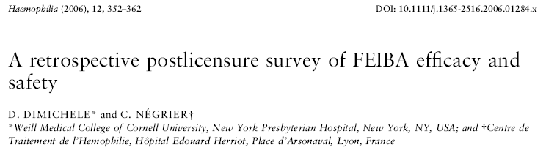
 | Pre-/Intraoperative Infusions | Post-operative Infusions | Days of Treatment | Total Dosage (U/kg)
Major Surgery (N = 4) | 2 (1-5) | 21 (12-31) | 9 (6-14) | 1174 (480-1693)
Minor Surgery (N = 12) | 1 (1-2) | 9 (1-33) | 11 (1-74) | 748 (142-2550)

Slide 22
Case 4
58 year old with hypertension
Had a biopsy of a lung mass
BP dropped, bleeding noted during procedure
Hgb is 8 g/dl
PT is 13 sec, aPTT 58 sec
Lupus anticoagulant is positive

Slide 23
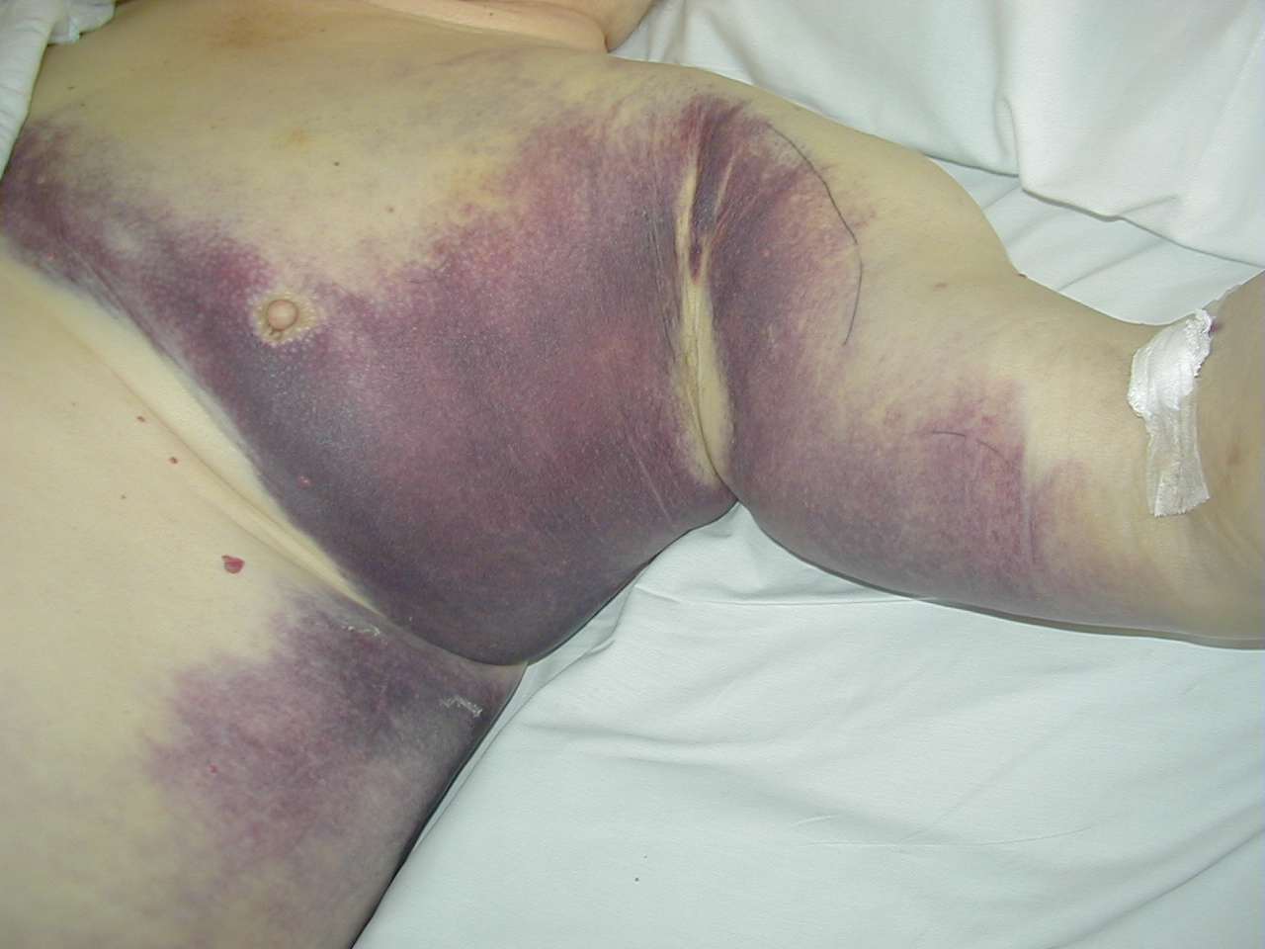

Slide 24
Classification of Inhibitors
Lupus anticoagulant (some are anti-Prothrombin)
Factor VIII inhibitors
Factor X inhibitors (amyloid)
Factor V inhibitors (anti-bovine factor V)
Factor XIII inhibitors
Anti-thrombin, anti-VII, etc.

Slide 25
Acquired Inhibitors
Can occur against any clotting factor
Most commonly factor VIII
0.2 – 1.0 case per million per year
Many are unrecognized unless trauma or surgery occurs
80-90% present with major hemorrhage
10-22% mortality

Slide 26
Epidemiology
Age 60-80 years
Most without underlying disease
Some associated with other disorder
  Systemic lupus erythematosus, rheumatoid arthritis
  Multiple sclerosis, graft vs host disease post BMT
  Asthma, IBD, pemphigus
  Reactions to penicillin, sulfonamides, interferon, BCG
  Pregnancy

Slide 27
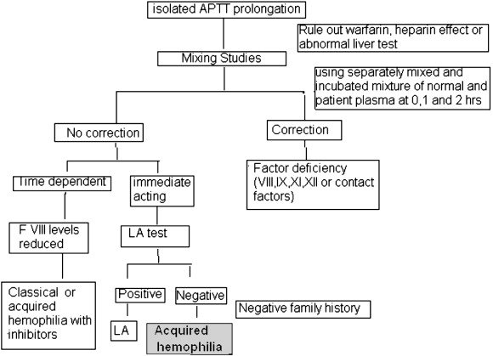
How to Work Up a Prolonged PTT

Slide 28
Case 4 Lab Results
Mixing study:
  Pre: 58 sec; Control: 28 sec; 1:1 45 sec; 2 hour incubation 60 sec
  Factor VIII <5%
  Bethesda titer 20 BU
Chest X-Ray: RUL mass
CT brain, PET, Bone scan without other lesion

Slide 29
Case 4 Treatment
Porcine factor VIII not available
Treated with FEIBA with resolution of bleeding
Prednisone and cyclophosphamide started
No response after 3 weeks
Biopsy of lung lesion - Adenocarcinoma
Carboplatin/Paclitaxel x 4 with resolution of inhibitor
Tumor resected completely, no recurrence

