Slide 1
Thrombotic Complications
in
Hematologic Malignancies
Hau C. Kwaan, MD, FRCP
Marjorie C Barnett Professor of Hematology-Oncology
Division of Hematology and Oncology
Northwestern University Feinberg School of Medicine
Chicago, IL, U.S.A.
NO CONFLICTS TO DECLARE
The Third
International Hematologic Malignancy Conference
February, 2012

Slide 2
Incidence
Pathophysiology
APL, Myeloma, Lymphoma, MPN
Management

Slide 3
Incidence
One year Pre-cancer –
(White et al,2005) >500,000 Calif. population - SIR
All cancers - 1.3
Ac. myeloid leukemia - 4.2
Non-Hodgkin’s lymphoma - 2.7
Renal cell, ovarian, pancreatic carc. - 2.5
During chemotherapy –
(Khorana et al,2009) >66,000 patients - All cancers 6 - 8%
Hematologic malignancies 18%
(Bloom et al,2005) 3220 patients - Solid tumors OR 1.8-22.2
Hematologic malignancies OR 28.0

Slide 4
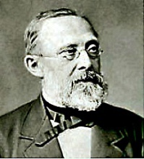
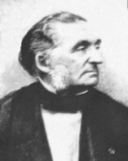
Thrombosis in Cancer – Present Day Concept of Virchow’s Triad
1. Abnormal Blood Flow
Hyperviscosity from:
Immunoglobulins
Erythrocytosis
Hyperleukocytosis
Thrombocytosis
Tumor compression
Immobilization
2. Abnormal Blood Vessels
Mechanical: Tumor invasion, Angiogenesis
Cytokines: Proinflammatory (IL-1b, TNFa, MCP-1)
Proangiogenic (IL-8, VEGF)
Endothelial cell activation (P-selectin, microparticles,
neutrophil elastase, endothelin, PGL-1,PAF)
Virchow (1821-1902)
3. Blood Content in Tumor Cells
3. Abnormal Blood Content
In Plasma
Immunoglobulins
Factor VIII/VWF, TF
Acquired APC resistance
P-selectin/PSGL-1
Microparticles
PAI-1, PAI-2
Co-morbid thrombophilia
Hereditary thrombophilia Antiphospholipidsyndrome
Tumor Cells
Tissue factor
Cancer procoagulant
Factor V receptor
PAI-1, PAI-2
Released by apoptosis
Spontaneous
Chemotherapy
Radiation
Trousseau
(1801-1867)
Tissue Factor
activation
Coagulation
thrombin generation
Fibrin formation
Thrombosis
Modified from Kwaan et al, 2007

Slide 5
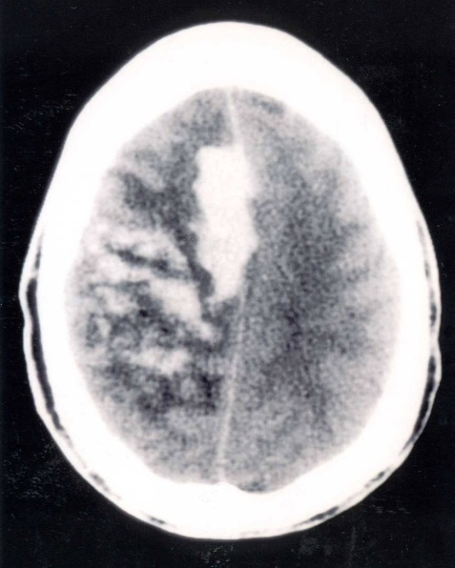
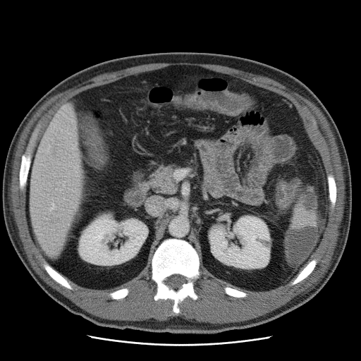
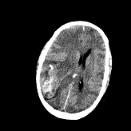
Double Hazard of Thrombosis and Hemorrhage in APL
Thrombosis: 12 – 25 %
≈ 30% during induction)
Cause of early death:
60% due to bleeding
≈ 80% bleeding are ICH
Intracranial hemorrhage Splenic and renal infarction
At diagnosis
2 weeks after induction with ATRA + chemotherapy
Courtesy of Drs.Winter and Tallman

Slide 6
Acute Promyelocytic Leukemia
1. Tissue Factor - procoagulant – initiates the coagulation cascade
Dormant (Encrypted) in the intact cell, but activated by phospholipids
e.g., phosphatidyl serine in apoptosis during
lipid peroxidation (free oxygen radicals) chemotherapy
Increased expression by leukemic cells (up to 300 fold in APL)
Up-regulated by cytokines: inflammatory (TNFα, IL-1β)
tumor derived cytokines (IL-6)
2. Cancer procoagulant - direct activation of Factor X
3. Fibrinolytic inhibitors - PAI-1, PAI-2
Microparticles – 0.03-0.1µ ; Kwaan, 2010
contain active tissue factor, PAI-1, annexin A2, tPA,
derived from leukemic cells, endothelium, platelets, monocytes
upregulated by inflammatory cytokines

Slide 7
ACUTE PROMYELOCYTIC LEUKEMIA
Thrombocytopenia
Promyelocyte
Apoptosis
Infection
ATRA
TNFα, IL-1,2 ,6
tPA
uPA
Tissue factor
Annexin A2
PAI-1
Differentiation
syndrome
Activation of
Coagulation cascade
Fibrinolysis
Fibrinolysis
Leukocytosis
DIC
Bleeding
Thrombosis
Kwaan, 2011

Slide 8
Management
Coagulopathy resolves 5-7 days after starting ATRA or ATO
Early death 17 – 29% -- little change over time /ATRA
Heparin is not effective for the coagulopathy
Antifibrinolytic agents are not able to prevent ICH
Thus,
Start ATRA as soon as feasible.
Aggressive blood product support (Tallman 2009)
Do not forget – high risk group - High white count,
Thrombocytopenia
Low fibrinogen
ATRA started > 1day after presentation has higher mortality (Altman 2011)

Slide 9
Pathogenesis of Prothrombotic State in Myeloma
Myeloma cells
B.M. stroma cells
vWF, FVIII, VII, IX, fibrinogen
“thrombin potential”
Bortezomib (Zangari,2011)
platelet aggregation
Overexpression
KLF 2, KLF4
Suppression of NF-κB
PAI-1
Thalidomide
IL-6, TNFα, VEGF
Tissue Factor expression
TM on EC
apoptosis
Protein C activation
Dexamethasone (Hi-dose)
Tissue Factor activation
Expression of adhesion molecules
Risk of Thrombosis
Expression of PAI-1
fibrinolysis
Coagulation activation
Anthracycline
apoptosis
Tissue Factor on monocytes
Risk of Thrombosis
Protein C activation

Slide 10
Multiple Myeloma
Effect of drugs on the tncidence of VTE in newly diagnosed patients
Thalidomide alone 4%
Thalidomide + Hi-dose Dex 17%
Thalidomide + Melph + Pred 20%
Thalidomide + Anthracyline 26%
Lenalidomide alone 0%
Lenalidomide + Hi-dose Dex 15%
Lenalidomide + low dose Dex 0%
(Wun and White, 2010)

Slide 11
Thromboprophylaxis in Myeloma
Thromboprophylaxis
(VTE/100 patient cycles) with LMWH
Thal alone 1.3 >> 0.5
Thal + Hi-DEX 4.1 >> 2.1
(VTE/100 patient cycles) with Warfarin
Thal + Dex + chemo-combinations 6.7 >> 3.5 (Carrier et al, 2011)
Internationl Myeloma Working Group 2008
For low risk (lenalidomide or low dose dexamethasone)
ASA 81mg/day
For high risk (Hi-dose Dex or Anthracycline combinations)
LMW Heparin or full intensity Warfarin (INR 2-3)

Slide 12
Lymphoma
Incidence depends on type, grade and tumor burden.
Primary CNS lymphoma : 59.9%, HL: 8.1%, NHL :1.5%
Microparticles in lymphoma : increased in TF
reduced after remission
TF CD 20 CD41a TF/CD 20 TF/CD41a

Slide 13
Myeloproliferative Neoplasms
Risk factors: Age>60; Prior history of thrombosis (Marcioli 2011;Babui 2011)
No correlation with H’crit, plt ct. But with WBC >15K.
Risk correlates with JAK2V617F allele burdern(Vannucchi 2008;Lussana,2009)
Inflammatory cytokine activation of monocytes, platelets and
endothelial cells (Babui 2011)
Microparticles: increase in TF.
TF present in MP derived from monocytes and
platelets
Percent of microparticles
TF CD 14 CD41a TF/CD 14 TF/CD41a

Slide 14
Summary
The incidence of venous thromboembolism is higher
in hematologic malignancies than in most solid tumors.
In acute promyelocytic leukemia, there is increased risk
of both thrombosis and bleeding.
In myeloma, the major determinant in the risk of thrombosis
is the choice of drugs in the management.
In myeloproliferative neoplasms, tissue factor derived from
monocytes and from platelets.

Slide 15
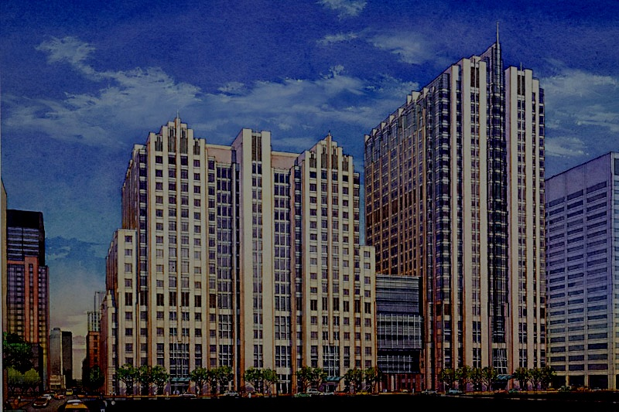
Acknowledgement
Martin Tallman
Eduardo Rego
Anaadriana Zakarija
Jessica Altman
Brandon McMahon
Brady Stein
Ivy Weiss
Jun Wang

Slide 16
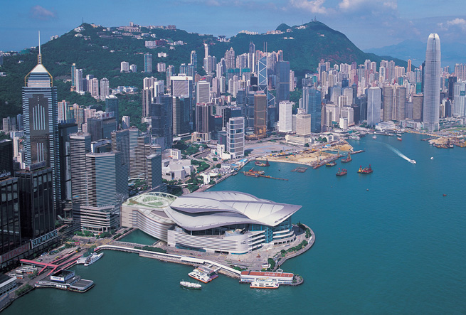
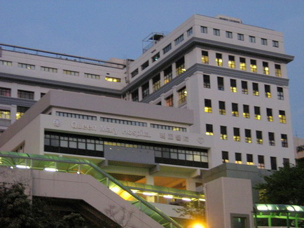
THANK YOU
Queen Mary Hospital

